Slide 1

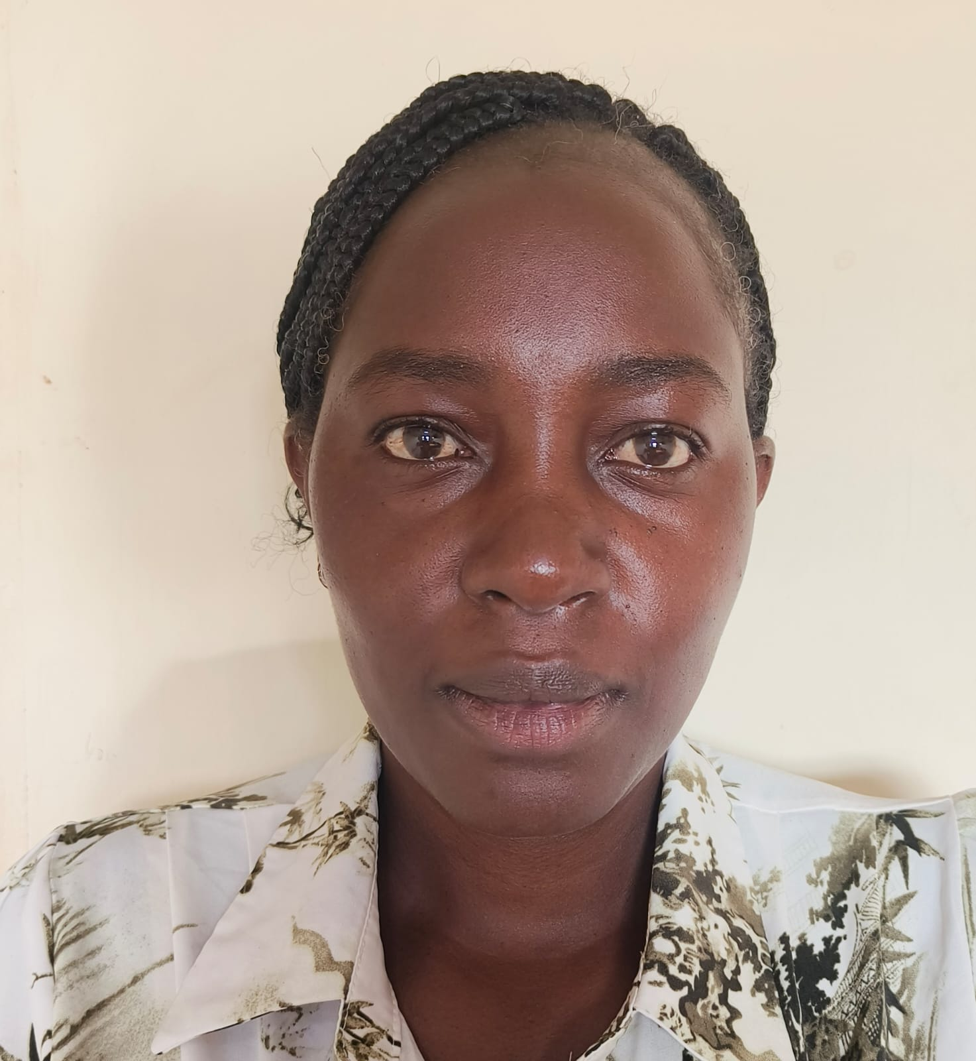
Detection of MRSA colonization in patients admitted at JM Kariuki County Hospital in Nyandarua County, Kenya
Head Shot
Emma Nyambura Wanjenga
MLO
J.M. Kariuki County Referal Hospital, Nyandarua County
Department of Health

Slide 2
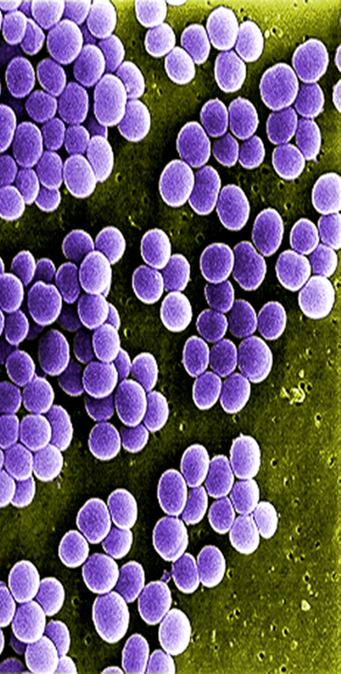
Introduction
MRSA, S. aureus resistant to methicillin and other commonly used antibiotics (Guo et al., 2020).
It causes Mild to severe infections ranging, pneumonia, and surgical site infections (
Transmission through direct contact with infected wounds or contaminated hands/surfaces.
All MRSA possess a copy of the mec gene that codifies penicillin binding proteins with low affinity for beta-lactams (mecA, mecB, mecC)
MecA genes are responsible for antibiotic resistance(Hindy & Kanj, 2022)
MRSA causes increased multidrug resistance, morbidity and mortality rates (Nandhini, et al., 2022)
Fig. 1; Gram Stain Presentation

Slide 3

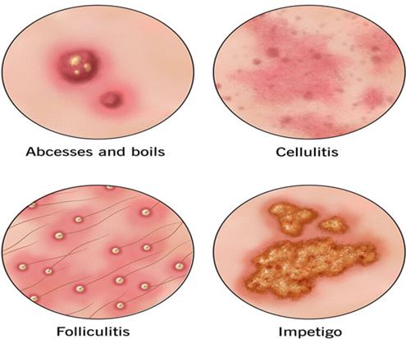
Objectives
Broad Objective: Isolation, AMR profiles and genotypic characteristics of MRSA among adult patients admitted in JM Kariuki County Hospital, Nyandarua County, Kenya.
Specific Objectives:
To determine the prevalence of MRSA among patients admitted at JM Kariuki hospital
To identify the AMR patterns of MRSA isolates from admitted patients.
To identify the presence of MRSA-associated genes
To analyse the social demographic and clinical characteristics MRSA infected patients.
Fig.2 Infection Presentations

Slide 4
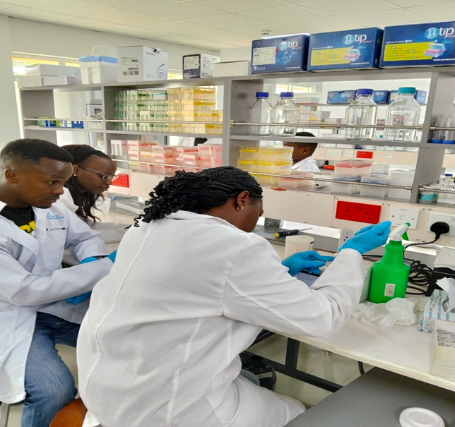
Methodology
Study Design: A descriptive cross-sectional laboratory-based design.
Study Area: JM Kariuki County Hospital, Nyandarua County, Kenya, targeting inpatients admitted in the general wards.
Sample Collection: From consenting adults targeting 3 anatomical sites i.e. Anterior nares, groins, and armpits
Inclusion: All conscious consenting adults
Exclusion: Unconscious and non consenting adults
Study Population: A total of 380 adults in both female and male wards consented participation.
Data Analysis-Microsoft Excel and SPSS version 29.0
Ethical Consent- MKU,NACOSTI,JM.KARIUKI

Slide 5
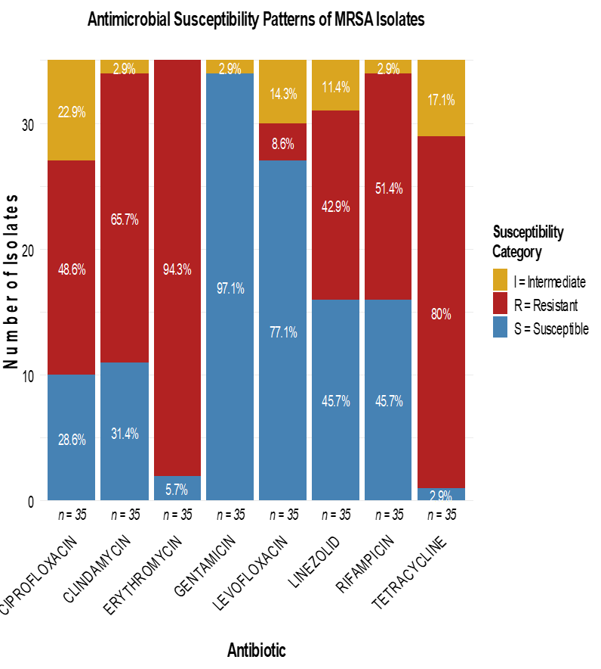
Results
The prevalence of MRSA was 9.2%(35/380) [6.5-12.5%|95% CI].
Above 65% resistance rates were witnessed on macrolides and lacosamide ( erythromycin, clindamycin, and tetracycline)
More than 77% sensitivity was observed on gentamicin and levofloxacin.
Rising resistance rates to linezolid, rifampicin, clindamycin, and ciprofloxacin presenting more than 42% raising Critical health concern.
Antibiotic usage was Ceftriaxone (40%) and flucloxacillin (11.5%) (n=35)
94.3% (33/35) of the MRSA presented mec A genes.

Slide 6
Results
• Linezolid and Rifampicin are the last-resort antibiotics used to treat serious infections..
This signifies emergence of limited treatment options, extensive drug resistance, and worsened treatment outcomes.
Among positive participants, female (66%), young adults (25-44 (34%) , older adults (60+ years).

Slide 7
Discussion
The MRSA prevalence was 9.2% which is comparable to meta-analysis by Azzam, et al., 2025 (12-30%) across Africa
MRSA are highly prevalent in Urban towns (15-25%) compared to rural Nyandarua (Gitau et al., 2018; Ayoyi et al., 2017).
The erythromycin and tetracycline resistance similar to a Nakuru study (Omuse et al., 2016)
Levofloxacin and Gentamicin are great treatment options for MRSA (MOH, 2020).
Extensive use of empirical antibiotics in primary care has led to increased AMR.

Slide 8
Conclusion and Recommendation
Provided emphasis on the impacts of MRSA in Nyandarua County.
Gentamicin and Levofloxacin were most efficacious drugs against MRSA.
Mec A are predominant among the MRSA isolated(~94%), with most colonizing auxiliary region.
Regular MRSA screening, sanitation, improved contact precautions, and sensitisation on IPC programs.
Implementation of Multifaceted strategies on community engagement and policy reforms
Strict hygiene, infection control, and responsible antibiotic use, are essential

Slide 9
References
Guo, Y., Song, G., Sun, M., Wang, J., & Wang, Y. (2020). Prevalence and Therapies of Antibiotic-Resistance in Staphylococcus aureus.
Nandhini, P., Kumar, P., Mickymaray, S., Alothaim, S. A., Somasundaram, J., & Rajan, M. (2022). Recent Developments in Methicillin-Resistant Staphylococcus aureus (MRSA) Treatment.
Nandhini, P., Kumar, P., Mickymaray, S., Alothaim, S. A., Somasundaram, J., & Rajan, M. (2022). Recent Developments in Methicillin-Resistant Staphylococcus aureus (MRSA) Treatment.
Hindy, J.-R. H., & Kanj, S. S. (2022). New drugs for methicillin-resistant Staphylococcus aureus skin and soft tissue infections

Slide 10
THANK YOU

